Slide 1
Interactive Visual Data Analysis
09 – Models and concepts of interaction

Slide 2
Objectives
Why is interaction important for visual data analysis: Learn interaction intents and action patterns
How does interaction work conceptually: Learn basic principles of human-computer interaction
What makes good (and bad) interaction: Learn about requirements and guidelines for interaction
What are basic interactions for interactive visual data analysis: Learn the fundamental interaction functionality required

Slide 3
Overview
Human in the loop
Interaction intents and actions patterns
The action cycle
Requirements
Interaction costs
Directness of interaction
Design guidelines
Basic operations
Taking action
Generating feedback

Slide 4
Human in the loop
Why is interaction with the user necessary?
Clear problem, answer can be computed, do:
Computation
Ill-defined problem, answer can hardly be computed, add:
Visualization
If single computation and visual representation do not suffice, add:
Interaction
Many real-world problems are here!

Slide 5
Human in the loop
Why is interaction with the user necessary?
Think about: What computers are good at?
Produce crisp results
Memory exact rather than approximate
Repetitive computations without getting tired
…
Think about: What humans are good at?
Creativity
Complex reasoning
React to the unexpected
…
→ Need an interplay between human and computer, the “human in the loop”!

Slide 6
Human in the loop
Why is interaction with the user necessary?
Visualization allows us to see things that we could otherwise not see
Interaction allows us to do things that we could otherwise not do
“
A graphic is not ‘drawn’ once and for all; it is ‘constructed’ and reconstructed until it reveals all the relationships constituted by the interplay of the data. The best graphic operations are those carried out by the decision-maker himself.
— Bertin, 1981
“
While visual representations may provoke curiosity, interaction provides the means to satisfy it.
— Tominski & Schumann, 2020

Slide 7
Human in the loop
Why is interaction with the user necessary?
Required degree of interactivity varies depending on the pursued goal
Goals High degree
Exploration
Description
Explanation
Confirmation
Presentation
Low degree

Slide 8
Interaction intents and action patterns
Obviously interaction is necessary and helpful
But what actuates users to interact and what interactions are common?
High-level interaction intents
More fine-granular list of action patterns

Slide 9
Interaction intents and action patterns
Interaction intents (Yi et al., 2007)
Capture why users interact
Seven main categories of interaction intents
Mark something as interesting
Show me something else
Show me a different arrangement
Show me a different representation
Show me more or less detail
Show me something conditionally
Show me related things

Slide 10
Interaction intents and action patterns
Interaction intents (Yi et al., 2007)
Mark something as interesting
Mark interesting parts in the data
Transient (short-term) vs. permanent (long-term) marking
Show me something else
Usually, data only partially visible
Explore different parts of the data
Show me a different arrangement
Arrange data differently to obtain different insights
Example: Arrange data wrt. time T or space S or attributes A

Slide 11
Interaction intents and action patterns
Interaction intents (Yi et al., 2007)
Show me a different representation
Adapt the visual encoding for exploration, verification, and presentation
Example: Adjust color scale according to data and task
Show me more or less detail
Get from overview to details
Balance conflicting demands of studying subtleties and seeing the big picture
Show me something conditionally
Show only those data that adhere to certain conditions or search criteria
Dynamically filter out or attenuate irrelevant data to clear view on relevant data

Slide 12
Interaction intents and action patterns
Interaction intents (Yi et al., 2007)
Show me related things
Based on already made observations, find similar or related parts of the data
Find, compare, and evaluate relations in the data

Slide 13
Interaction intents and action patterns
Interaction intents (Yi et al., 2007)
Two additional categories of interaction intents
Let me go back to where I’ve been
Support exploratory workflows
Return to previous states of the data analysis
Let me change the interface
Adjust not only the visualization, but also the overall data analysis system
Configure the user interface and manage system resources
Intents capture reasons for active participation of users, next we look at more concrete action patterns

Slide 14
Interaction intents and action patterns
Action patterns (Sedig & Parsons, 2013)
Capture what users actually do when interacting
Two types of action patterns can be distinguished
Unipolar
Actions only performed in one direction
No natural opposite action
Can be reversed only with a generic undo action
Bipolar
Pairs of actions
One action is natural opposite of other action

Slide 15
Interaction intents and action patterns
Action patterns (Sedig & Parsons, 2013)
Unipolar
Pattern | Description
Arranging | changes ordering, either spatially or temporally
Assigning | binds features or values to be encoded
Blending | fuses visual representations together to form one entity
Comparing | determines similarities or differences
Drilling | brings out and displays interior, deep information
Filtering | displays subsets obeying certain criteria
Navigating | moves on, through, and around the data
Selecting | focuses on or chooses either individuals or groups

Slide 16
Interaction intents and action patterns
Action patterns (Sedig & Parsons, 2013)
Bipolar
Think about: What other bipolar action patterns exist?
Pattern | Description
Collapsing/ Expanding | fold in and compact visual items, or oppositely, fold them out or make them more diffuse
Composing/ Decomposing | assemble and join together to create holistic representations, or oppositely, break up into separate components
Linking/ Unlinking | establish relationships or associations, or oppositely, dissociate and disconnect relationships
Storing/ Retrieving | put aside for later use, or oppositely, bring stored items back into usage
Notes:
Accelerating/Decelerating: increase or decrease the speed of movement of visual components
Gathering/Discarding: gather views into collections, or oppositely, throw them away completely
Inserting/Removing: interject new views, or oppositely, get rid of unwanted or unnecessary portions

Slide 17
Interaction intents and action patterns
We know now about the why (interaction intents) and the what (action patterns) of interaction for visual data analysis
Let’s next look at the how
Norman’s action cycle

Slide 18
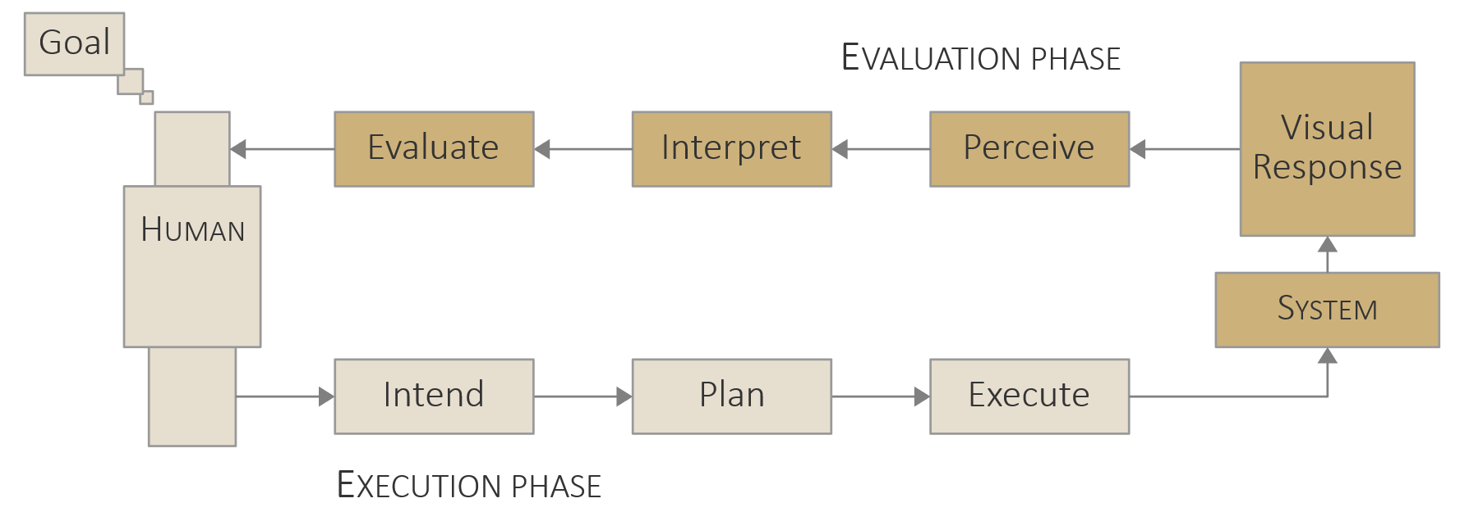
The action cycle
General interaction model by Norman (1988 and 2013)
Here adapted to interaction with a computer system
Here we see the human in the loop!

Slide 19
The action cycle
Phases and actions
Goal: Overall goal for interacting
Execution phase
Intend: Develop desire to change something
Plan: Specify actions to accomplish desired change
Execute: Perform the planned actions
Evaluation phase
Perceive: See the response of the system
Interpret: Understand the response of the system
Evaluate: Compare response with desired outcome (re-run loop if necessary)

Slide 20
The action cycle
Levels of processing
Reflective
Behavioral
Visceral

Slide 21
The action cycle
Levels of processing
Visceral (instinctive)
Quick, basic mechanisms, subconscious, without awareness and control
Behavioral
Quick, learned skills, largely subconscious, little awareness, controlled
Reflective
Slow, deep analysis, conscious, full awareness and control

Slide 22
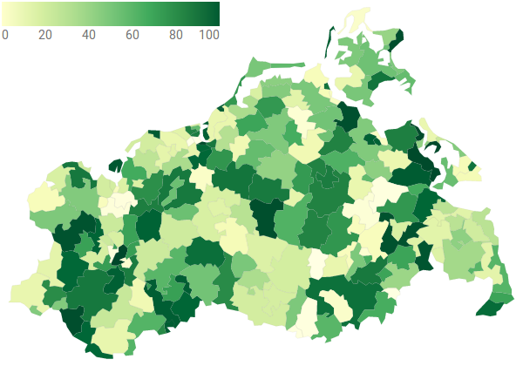
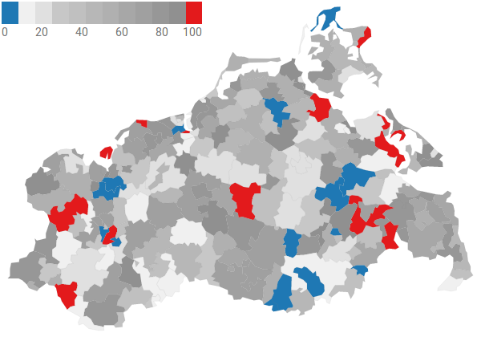
The action cycle
Example
Goal: Locate extrema
Intend: Adjust color scale
Plan: Need to operate color selector
Execute: Move mouse to select alternative color scale
Perceive: Visual representation changes its colors
Interpret: Extrema now clearly visible in red and blue
Evaluate: Success, extrema could be located
In practice, the loop usually runs many times due to the dynamically changing interests of users during the visual data analysis!
Recall the loops of the knowledge generation process from Lecture 3.

Slide 23
The action cycle
Levels of interaction
Depending on the number of operations performed
Low-level interaction
Mapping fundamental degrees of freedom of interaction devices to basic operations of pointing and manipulating graphical objects
Interaction alphabet or syntax
Intermediate-level interaction
Low-level interactions combined to semantically meaningful activities
Interaction vocabulary
High-level interaction
Interaction vocabulary is employed to form longer action sequences
High-level problem solving and analytical thinking

Slide 24
Requirements for efficient interaction
We learned about why, what, and how of interaction
We now move on to the question: What makes good interaction?
Interaction costs
Directness of interaction
Design guidelines

Slide 25
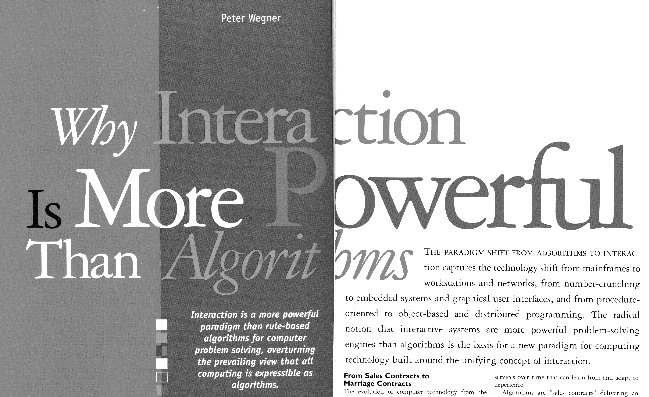
Requirements for efficient interaction
Arguments for interaction
“
Interaction is more powerful than algorithms: Algorithms are metaphorically dumb and blind because they cannot adapt interactively while they compute. They are autistic in performing tasks according to rules rather than through interaction. In contrast, interactive systems are grounded in an external reality both more demanding and richer in behavior than the rule-based world of noninteractive algorithms.
— Wegner, 1997

Slide 26
Requirements for efficient interaction
Arguments against interaction
Think about: When can interaction be harmful?
“
Interactivity considered harmful: […] interactivity has even worse problems than simply being a frustrating waste of time:
The user has to already know what she wants in order to ask for it. […] Purely interactive software forces the user to make the first move.
The user has to know how to ask. That is, she must learn to manipulate a machine. […]
Navigation implies state. Software that can be navigated is software in which the user can get lost. The more navigation, the more corners to get stuck in. The more manipulable state, the more ways to wander into a “bad mode.” State is the primary reason people fear computers—stateful things can be broken.
— Victor, 2006

Slide 27
Requirements for efficient interaction
Arguments for and against interaction!
So, what makes good interaction?
First of all, be aware of the costs of interaction (Lam, 2008)
Execution phase → “Gulf of execution”
Evaluation phase → “Gulf of evaluation”
Costs can be
Physical
Mental

Slide 28
Costs of interaction
Physical costs
Related to performing physical actions (e.g., moving fingers or forearms to control the mouse, or physically scanning the visual response)
Mostly visceral activities with little to no dedicated attention necessary
Examples of costly interactions
Many repetitive actions during exploratory data analysis
Deep menu structures that require long and accurate pointer movements
Much visual feedback distributed across screen requires much eye movement

Slide 29
Costs of interaction
Mental costs
Related to mentally preparing interactions and understanding the system’s response
Reflective and behavioral activities require users pay attention
Examples of costly interactions
Planning: Determine which graphical object afford which actions
Interpreting: Many simultaneous changes difficult to follow
Interpreting: Subtle changes hardly visible and interpret
Evaluating: Compare new visual representation against previous version from short-term memory

Slide 30
Costs of interaction
Think about: Should we try to tackle each and every analysis problem interactively?
No! Interaction is powerful, but not a silver bullet.
Interaction can be a burden if seemingly simple tasks are cumbersome to accomplish due to bad interaction design
Users may feel uncomfortable with being responsible for adjusting parameters
Unclear whether visible features corresponds to features in the data or are just artifacts of (inappropriate) interactive adjustments

Slide 31
Costs of interaction
Think of interaction in a less-is-more way
System should be responsible for relieving user of unnecessary work
Only as a last resort should input be requested from user, and the input should be made through a well-designed interactive interface
Question: How can interaction costs be reduced and the gulfs of execution and evaluation be narrowed?
Answer: Consider high degree of directness of interaction.

Slide 32
Directness of interaction
Directness with which interaction is carried out determines how smoothly and efficiently the action cycle can run
Direct manipulation paradigm:
“
Are we analyzing data? Then we should be manipulating the data themselves;
or if we are designing an analysis of data, we should be manipulating the analytic structures themselves.
— Hutchins et al., 1985

Slide 33
Directness of interaction
“
[Direct manipulation] can be defined as the use of continuous physical motions (of one’s hand) to interactively manipulate persistent visual representations of objects, with continuously updated feedback, and with the ability to undo actions by simply reversing physical motions.
— McGuffin & Fuhrman, 2020
Direct manipulation is the preferred interaction paradigm for interactive visual data analysis (Shneiderman, 1983)
Objects and actions of interest are presented continuously using meaningful visual metaphors
The user’s requests are expressed through physical actions, rather than complex syntax
Actions are rapid, incremental, and reversible, and their effect is immediately visible
But what does directness actually mean in terms of designing interactive visual data analysis solutions?

Slide 34
Directness of interaction
Look at directness from an opposite point of view: Directness is inversely proportional to the degree of separation of human actions and system responses
Different types of separation
Conceptual separation
Spatial separation
Temporal separation

Slide 35
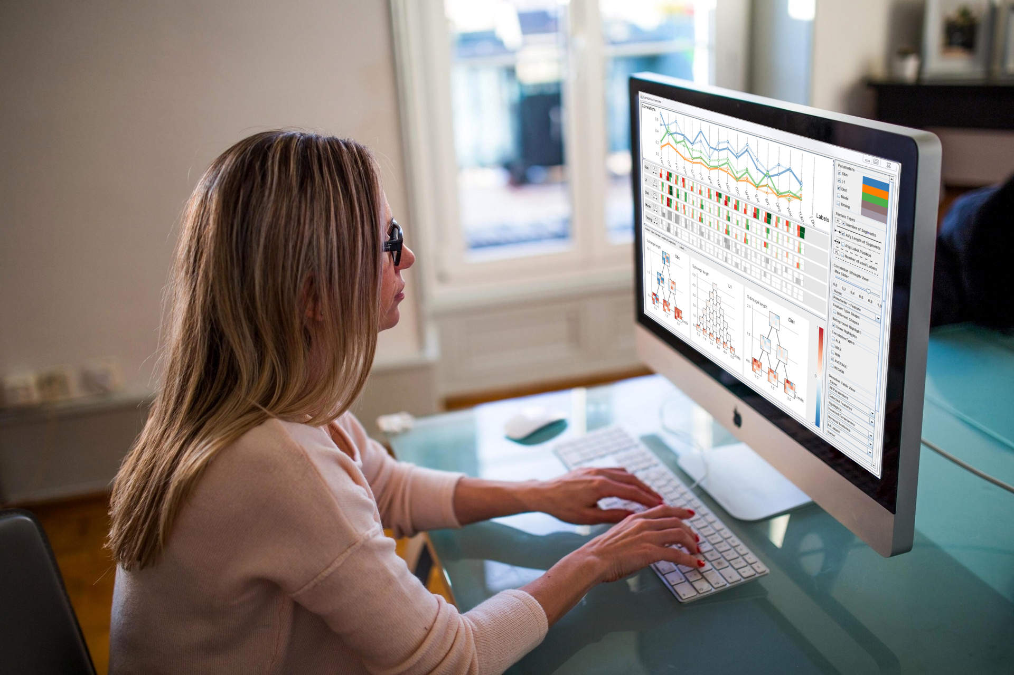
Directness of interaction
Conceptual separation
Model discrepancy
Spatial separation
Distance
Temporal separation
Latency

Slide 36
Directness of interaction
Conceptual separation
Due to differences between user’s mental model and system’s represented model

Slide 37
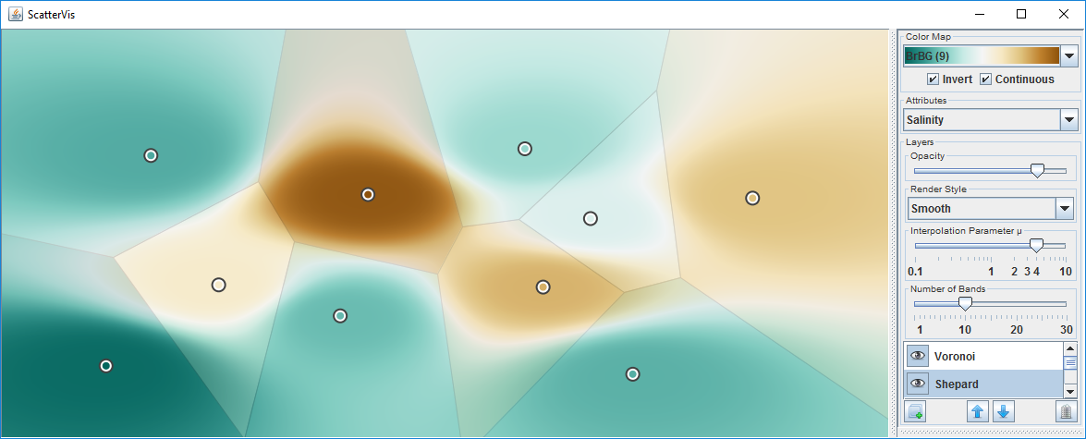
Directness of interaction
Spatial separation
Due to the spatial distance to be covered during interaction (e.g., pointer movements and eye movements)

Slide 38
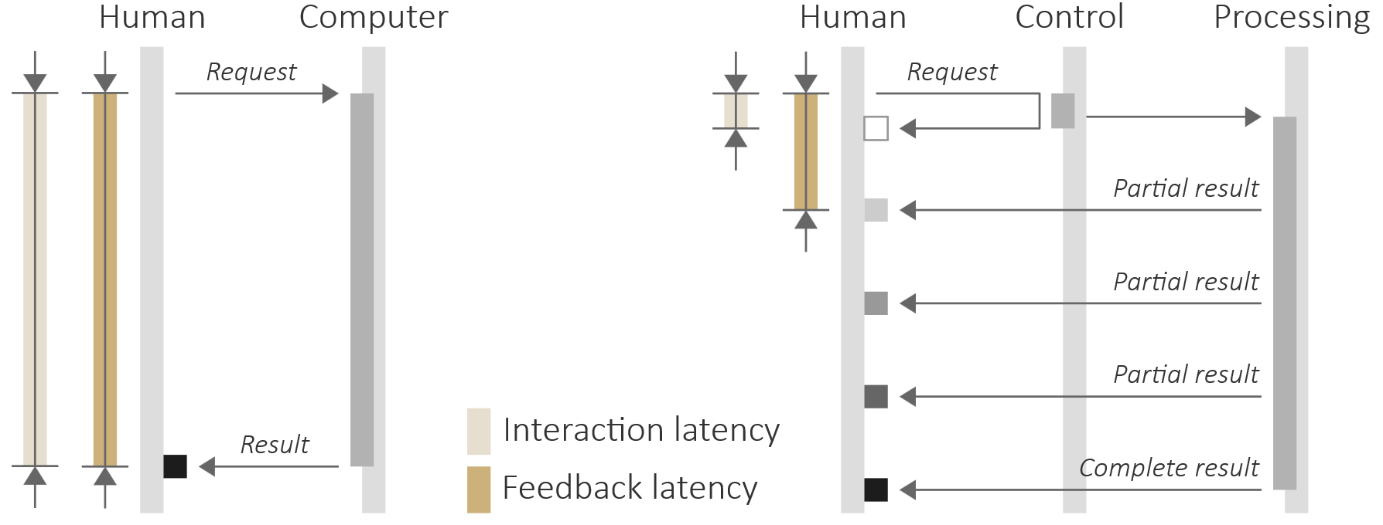
Directness of interaction
Temporal separation
Due to the latency between user’s actions and system’s response
Long-running computation may block interaction cycle
Progressive processing ensures system responsiveness

Slide 39
Directness of interaction
Scenarios of different directness
Example interaction: Zoom in to look at details of interesting nodes in a graph
Source code editing
Edit source code and compile (very low degree of directness)
Scripting commands
Execute scripting commands (moderate degree of directness)
Graphical interface
Control zoom via graphical controls (good degree of directness)

Slide 40
Directness of interaction
Scenarios of different directness
Direct manipulation
Use mouse to draw elastic rectangle around nodes (high degree of directness)
Direct touch
Use fingers to draw elastic rectangle (yet higher degree of directness)
Despite the seemingly clear preference for direct touch, each scenario has its advantages and disadvantages
Think about: What are these (dis)advantages?

Slide 41
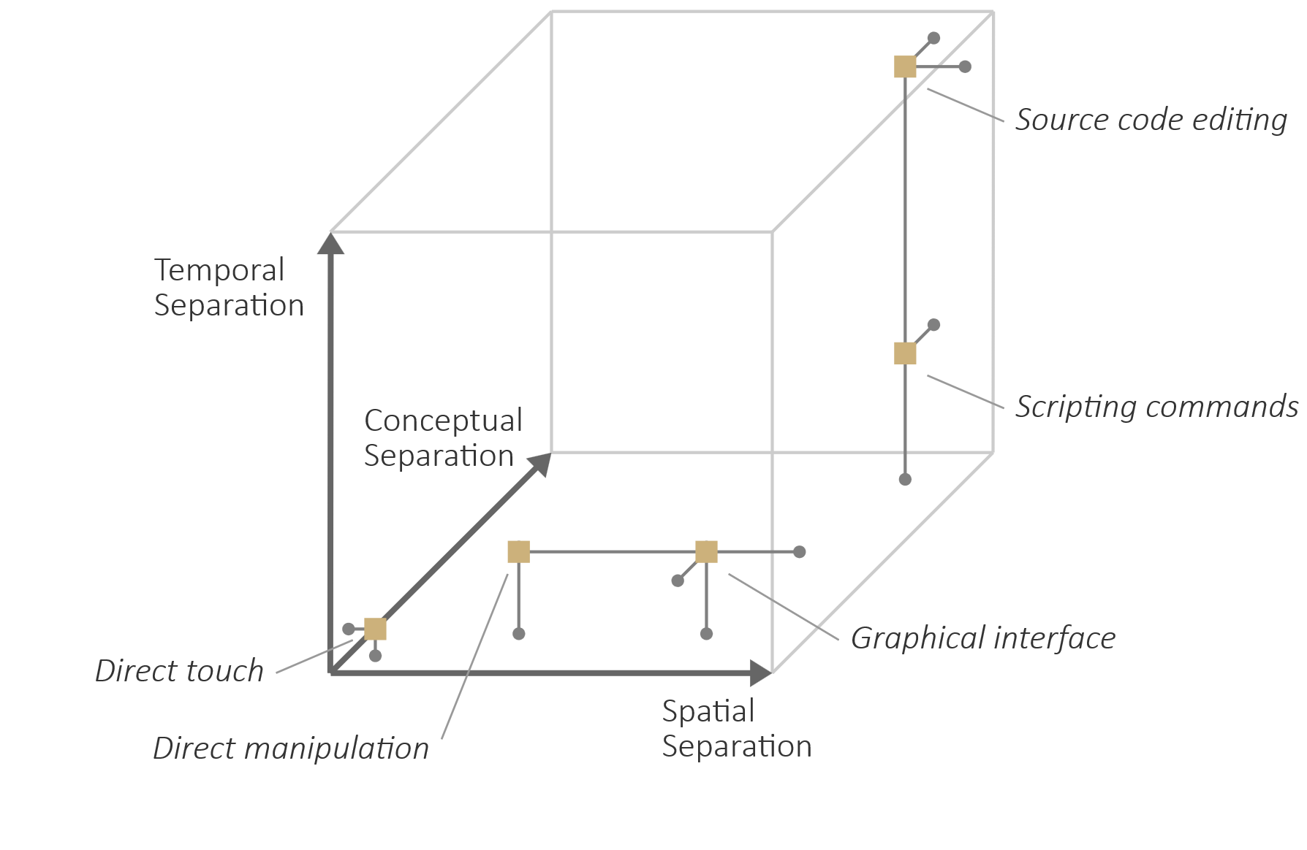
Directness of interaction
Scenarios of different directness
Summarizing view with approximate degrees of separation

Slide 42
Design guidelines
We learned that reducing separation leads to direct interaction, which in turn is good for reducing interaction costs
In addition to striving for directness, there are further design guidelines to be taken into account
Golden rules
Fluid interaction

Slide 43
Design guidelines
Golden rules (Shneiderman & Plaisant, 2010)
Strive for consistency. Consistent actions should be required in similar contexts and be responded to consistently.
Cater to universal usability. The system should be usable for novices, casual users, and experts alike.
Offer informative feedback. For each possible action, there should be informative feedback appropriate to its importance.
Design dialogs to yield closure. Action sequences should have a well-defined beginning, middle, and end.

Slide 44
Design guidelines
Golden rules (Shneiderman & Plaisant, 2010)
Prevent errors. The system should prevent serious errors and be able to recover from minor problems.
Permit easy reversal of actions. Actions should be reversible to allow for undoing accidental actions and to encourage exploration.
Support internal locus of control. Users should be given the feeling that they are in charge, not the computer.
Reduce short-term memory load. Short-term memory load should be limited to seven plus minus two chunks of information.

Slide 45
Design guidelines
Fluid interaction (Elmqvist et al., 2011)
Promote flow
Support direct manipulation
Minimize the gulfs of execution and evaluation
“
To be most effective, visual analytics tools must support the fluent and flexible use of visualizations at rates resonant with the pace of human thought.
— Heer & Shneiderman, 2012

Slide 46
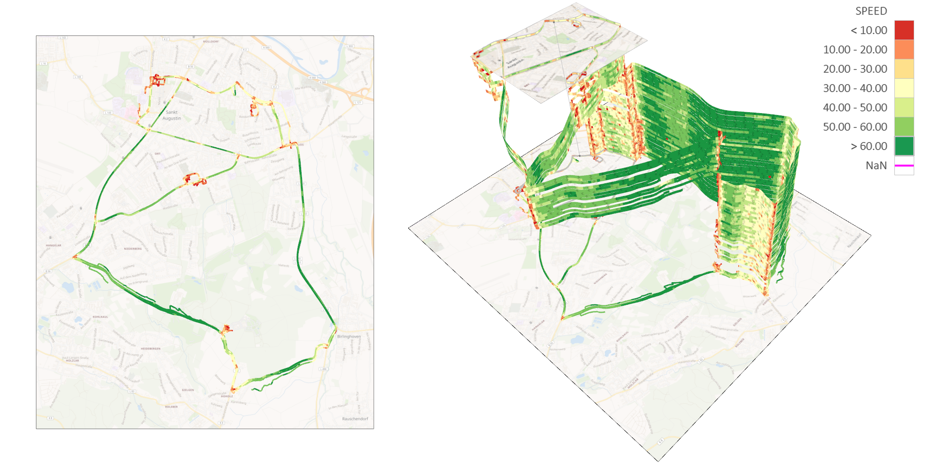
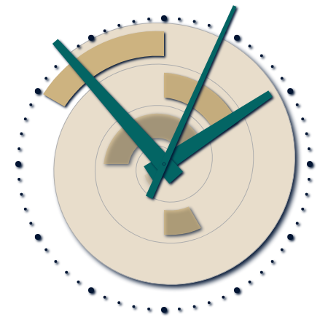
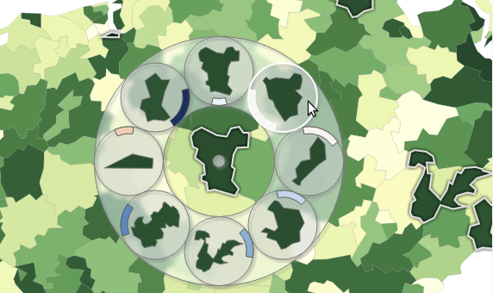
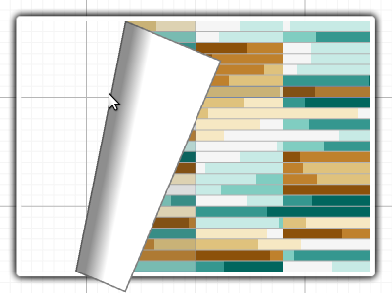
Design guidelines
Fluid interaction (Elmqvist et al., 2011)
Demos
SpiraClock
TrajectoryVis
FoldableVis
Bring’N’Compare

Slide 47
Basic operations
So far for the conceptual background of interaction for visual data analysis
Now we move on to the basic operations
Taking action
Generating feedback

Slide 48
Basic operations
Taking action
Three-state model by Buxton (1990)
Point: Where should the interaction take effect
Manipulate: What should the effect be

Slide 49
Basic operations
Taking action
Modes of interaction
Discrete (or stepped) interaction
Temporarily enter state 2 (e.g., click or touch)
Trigger discrete change in visualization
Good for selecting among few alternative choices
Continuous interaction
Stay in state 2 for a longer time (e.g., drag slider)
Continuously update the visualization
Good for browsing larger numbers of alternative choice

Slide 50
Basic operations
Generating feedback
Update
Change internal state of the visualization
Perform stages of the visualization pipeline as necessary
Refresh
Present new visual representation to make internal state change visible

Slide 51
Basic operations
Demo: Static vs. animated camera in TrajectoryVis
Generating feedback
Types of visual feedback
Static feedback
Immediately replace old state with new state
Can be good to attract attention
But instantaneous switch can make changes difficult to comprehend
Animated feedback
Smoothly transition between old state and new state
Can help users understand the state change
But animation takes time, which delays the action cycle

Slide 52
Summary
Human in the loop (intents, action patterns, Norman’s action cycle)
Requirements (interaction costs, directness, design guidelines)
Basic operations (point and manipulate, update & refresh, feedback)
Next lectures:
Basic interaction techniques
Advanced interaction techniques

Slide 53
Assignments
Experiment with the EnhancedSpiral.js and think about the modes of interaction that are provided!
Play with Responsive Matrix Cells and think about the types of feedback being offered!
Read “What is Interaction for Data Visualization” by Diamara and Perin (2020)!

Slide 54
Questions
How does the required degree of interactivity vary depending on visualization goals?
Name and explain 3 main categories of interaction intents!
What is the difference between unipolar and bipolar action patterns? Give examples!
Explain the phases and actions of Norman’s action cycle!
Characterize the different levels of processing involved in the action cycle!
Give arguments for and against interaction for visual data analysis?
What interaction costs are relevant in the context of visual data analysis?
When does interaction reach a high level of directness?
Name some golden rules to be taken into account when designing interaction!
Sketch and explain Buxton’s “three-state model”!
What are discrete and continues interaction, and static and animated feedback?

